Slide 1
Kotlin coroutines
Areeba Shahzad(15L-4378)
Amna Akram(17L-4059)
Hafsa Saleem (17L-4209)
Feza Roheel (17L- 4005)

Slide 2
Scenario
Make a request to a network(like retrofit) or access internal SQLite database
Doing it on the main thread blocks it,leaving the UI unresponsive
->Network On Main Thread Exception
APPLICATION CRASHES!!

Slide 3
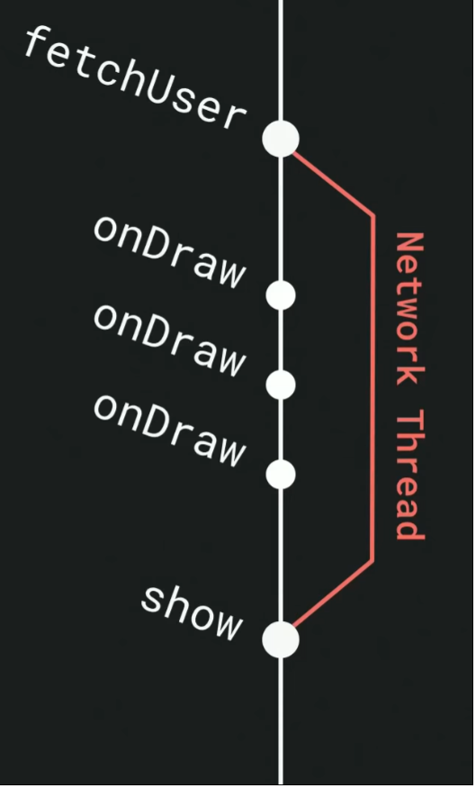
Solution? Use Java Threads!

Slide 4
Problems with Java Threads
Tasks waiting for IO blocks the thread itself
CPU sits idle -> wastage of CPU cycles
Threads are expensive(around 1MB), can’t create too many -> Out of Memory exception

Slide 5
Solution? Use Kotlin Coroutines
Another option for threading in android
Coroutines are like light-weight threads
Simplified asynchronous calls

Slide 6
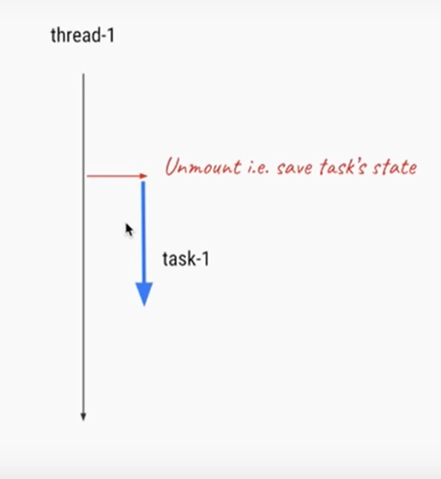
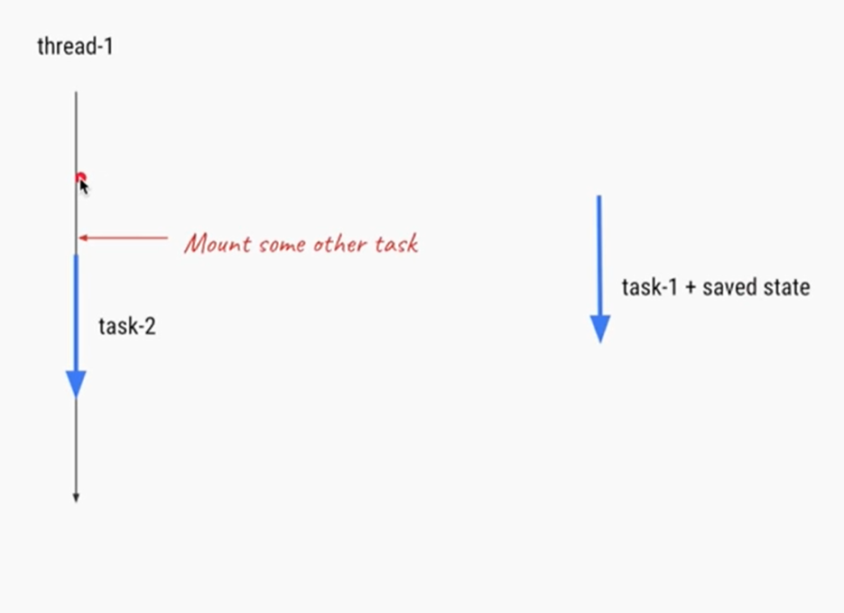

Slide 7
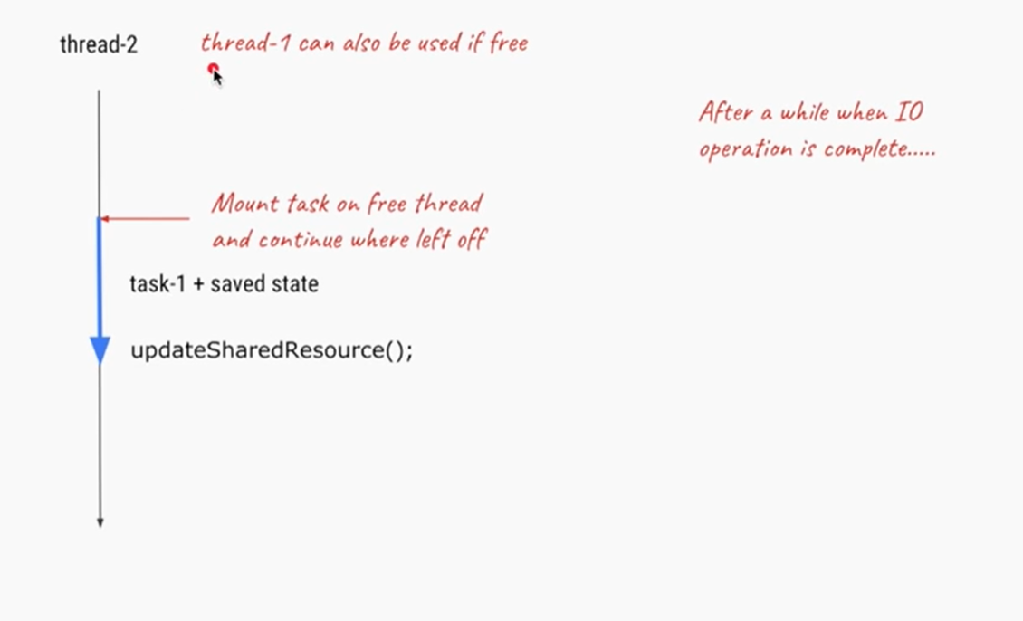

Slide 8
Advantages of coroutines
Manage long-running task
Coroutines are very cheap, saves memory
Lightweight and efficient
Support multitasking
Index for current state- you can manage, suspend and resume the current execution
Ability to wait patiently- tasks execute sequentially and coroutines can wait for the result.

Slide 9
Coroutine Leaks
Coroutine resumes itself
Can use Memory, CPU, write a file, make network request
Solution? Coroutine Scope
Coroutines run in a scope
Scope can cancel all coroutines
Use Scope to avoid LEAKS

